Slide 1


Shree Sampath, Anastasia Klonowski, and Manasi Thakkar

Slide 2

Step into someone else’s shoes!

Slide 3
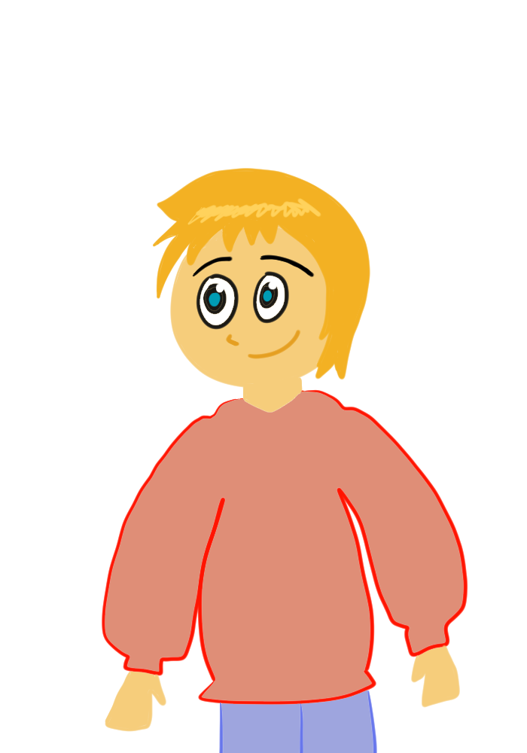
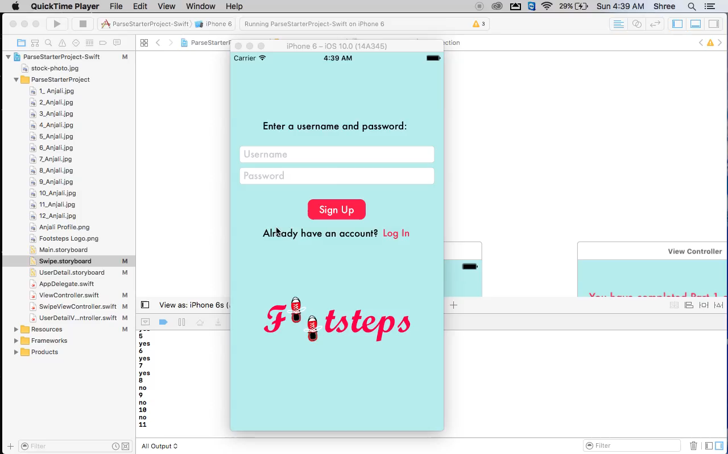
Nick

Slide 4
What did we use?
GitHub
Swift
Parse
Amazon Web Services

Slide 5
YES
NO

Slide 6
NO
16.90
83.10
YES

Slide 7
NO
5.63
94.37
YES

Slide 8
Thank you to…
The Emilies
Robbie
Mackenzie
BNY Mentor
&
Everyone who put SheInnovates together!

Slide 9

Thank You!

